Slide 1
Key Management and Distribution

Slide 2
Key Distribution
Key distribution is the function that delivers a key to two parties who wish to exchange secure encrypted data.
Mechanism/Protocol is needed to provide for the secure distribution of keys.
Key distribution often involves the use of master keys, which are infrequently used and are long lasting,
and session keys, which are generated and distributed for temporary use between two parties.

Slide 3
Key Distribution
Key distribution using Symmetric Encryption technique.
Key distribution using Asymmetric Encryption technique

Slide 4
Symmetric Key Encryption Technique
For two parties A and B, key distribution can be achieved in a number of ways, as follows:
A can select a key and physically deliver it to B.
A third party (C) can select the key and physically deliver it to A and B.
If A and B have previously and recently used a key, one party can transmit the new key to the other, encrypted using the old key.
If A and B each has an encrypted connection to a third party C, C can deliver a key on the encrypted links to A and B.

Slide 5
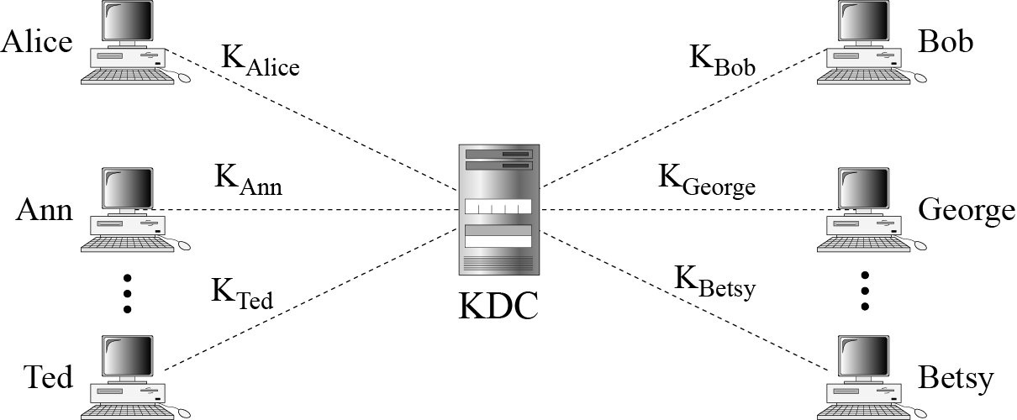
Symmetric Key Encryption Technique
A Key Distribution Scenario

Slide 6
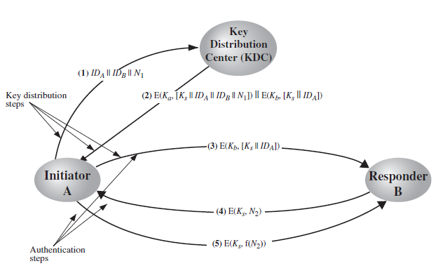
Symmetric Key Encryption Technique
A Key Distribution Scenario [Needham-Schroeder Protocol]

Slide 7
Symmetric Key Encryption Technique
A Key Distribution Scenario [Needham-Schroeder Protocol]
Used to securely distribute a new session key for communications between A & B
But is vulnerable to a replay attack if an old session key has been compromised then message 3 can be resent convincing B that is communicating with A
Modifications to address this require:
timestamps
using an extra nonce

Slide 8
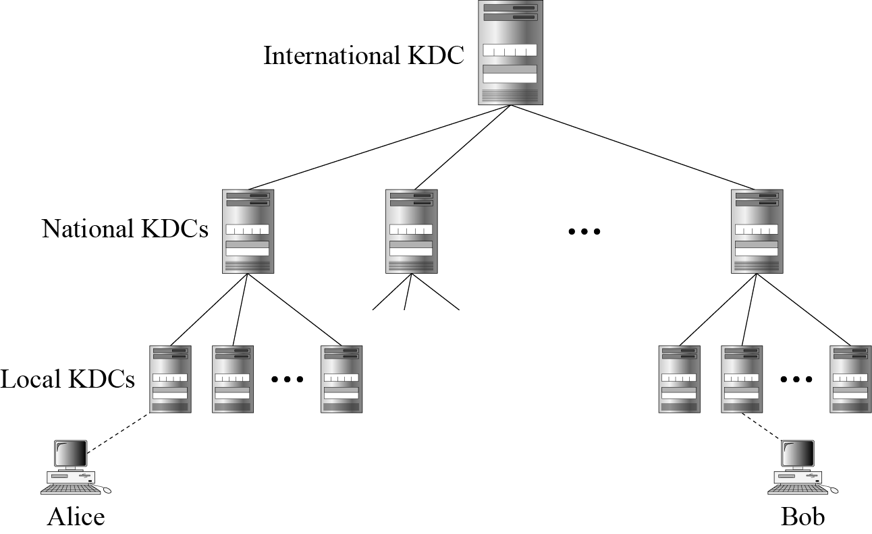
Symmetric Key Encryption Technique
Hierarchical Key Control

Slide 9
Symmetric Key Encryption Technique
Session Key Lifetime
The more frequently session keys are exchanged, the more secure they are, because the opponent has less ciphertext to work with for any given session key.
the distribution of session keys delays the start of any exchange and places a burden on network capacity.
try to balance these competing considerations in determining the lifetime of a particular session key.

Slide 10
Symmetric Key Encryption Technique
Session Key Lifetime
Connection-oriented protocol: Use the same session key for the length of time that the connection is open, using a new session key for each new session.
If a logical connection has a very long lifetime, then it would be prudent to change the session key periodically.
Connectionless protocol: The most secure approach is to use a new session key for each exchange.
It negates one of the principal benefits of connectionless protocols, which is minimum overhead and delay for each transaction.
A better strategy is to use a given session key for a certain fixed period only.

Slide 11
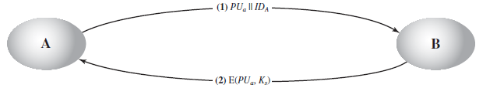
Asymmetric Key Encryption Technique
Merkle’s scheme
A generates a public/private key pair {PU_{a}, PR_{a}} and transmits a message to B consisting of PU_{a} and an identifier of A, ID_{A}.
B generates a secret key, Ks, and transmits it to A, which is encrypted with A’s public key.
A computes D(PR_{a}, E(PU_{a}, Ks)) to recover the secret key Ks. Because only A can decrypt the message.
A discards {PU_{a}, PR_{a}} and B discards PU_{a}.

Slide 12
Asymmetric Key Encryption Technique
Merkle’s scheme
Insecure against the man-in-the-middle attack.
A generates a public/private key pair {PU_{a}, PR_{a}} and transmits (PU_{a}||ID_{A}) intended for B.
Eve intercepts (PU_{a}||ID_{A}), creates its own public/private key pair {PU_{e}, PR_{e}} and transmits (PU_{e}||ID_{A}) to B.
B generates a secret key, Ks, and transmits E(PU_{e}, Ks).
Eve intercepts E(PU_{e}, Ks) and learns Ks by computing D(PR_{e}, E(PU_{e}, Ks)).
E transmits E(PU_{a}, Ks) to A.

Slide 13
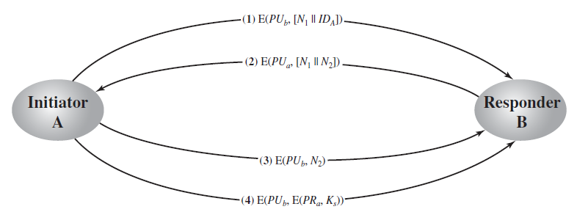
Asymmetric Key Encryption Technique
Secret Key Distribution with Confidentiality and Authentication
It is designed to provide protection against both active and passive attacks.
We begin at a point when it is assumed that A and B have exchanged public keys by the scheme discussed later.

Slide 14
Distribution of Public Keys
Several techniques have been proposed for the distribution of public keys. All these proposals can be grouped into the following general schemes:
Public announcement
Publicly available directory
Public-key authority
Public-key certificate

Slide 15
Distribution of Public Keys
1. Public Announcement of Public Keys
Any participant can send his or her public key to any other participant or broadcast the key to the community at large.
it has a major weakness. Anyone can forge such a public announcement.
some user could pretend to be user A and send a public key to another participant or broadcast such a public key. Until such time as user A discovers the forgery and alerts other participants, the forger is able to read all encrypted messages intended for A and can use the forged keys for authentication.

Slide 16
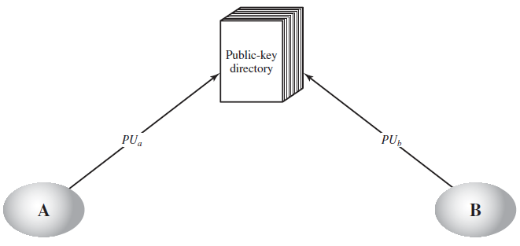
Distribution of Public Keys
2. Publicly Available Directory
A greater degree of security can be achieved by maintaining a publicly available dynamic directory of public keys.
Maintenance and distribution of the public directory would have to be the responsibility of some trusted entity or organization.

Slide 17
Distribution of Public Keys
Publicly Available Directory
The authority maintains a directory with a {name, public key} entry for each participant.
Each participant registers a public key with the directory authority. Registration would have to be in person or by some form of secure authenticated communication.
A participant may replace the existing key with a new one at any time, either because of the desire to replace a public key that has already been used for a large amount of data, or because the corresponding private key has been compromised in some way.
Participants could also access the directory electronically. For this purpose, secure, authenticated communication from the authority to the participant is mandatory.

Slide 18
Distribution of Public Keys
Shortcoming of Publicly Available Directory
This scheme is clearly more secure than individual public announcements but still has vulnerabilities.
If an adversary succeeds in obtaining or computing the private key of the directory authority, the adversary could authoritatively pass out counterfeit public keys and subsequently impersonate any participant and eavesdrop on messages sent to any participant.
Another way to achieve the same end is for the adversary to tamper with the records kept by the authority.

Slide 19
Distribution of Public Keys
3. Public-Key Authority
A central authority maintains a dynamic directory of public keys of all participants.
Each participant reliably knows a public key for the authority, with only the authority knowing the corresponding private key.

Slide 20
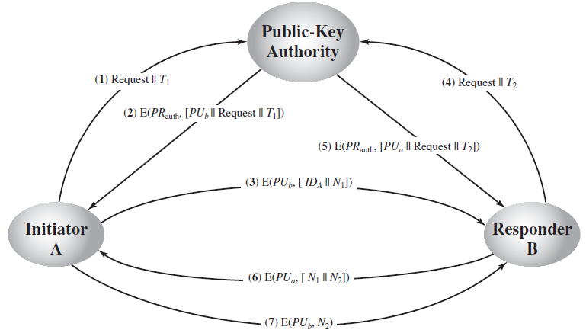
Distribution of Public Keys
Public-Key Authority

Slide 21
Distribution of Public Keys
Public-Key Authority
It has some drawbacks.
The public-key authority could be somewhat of a bottleneck in the system, for a user must appeal to the authority for a public key for every other user that it wishes to contact.
The directory of names and public keys maintained by the authority is vulnerable to tampering.
An alternative approach, first suggested by Kohnfelder (1978), is to use certificates that can be used by participants to exchange keys without contacting a public-key authority, in a way that is as reliable as if the keys were obtained directly from a public-key authority.

Slide 22
Certificates
Certificate format (X.509)
Version number
Serial Number
Signature algorithm ID
Issuer Name
Validity Period
Subject name
Subject public key
Issuer unique identifier
Subject unique identifier
extension
signature

Slide 23
Distribution of Public Keys
Public-Key Certificate
A certificate consists of
a public key
an identifier of the key owner, and
the whole block signed by a trusted third party
Typically, the third party is a certificate authority (CA), such as a government agency or a financial institution, that is trusted by the user community.
A user can present his or her public key to CA in a secure manner and obtain a certificate. The user can then publish the certificate.
Anyone needing this user’s public key can obtain the certificate and verify that it is valid by way of the attached trusted signature.
VeriSign, Entrust, Safescrypt
https://en.wikipedia.org/wiki/Certificate_authority

Slide 24
Distribution of Public Keys
Public-Key Certificate
A participant can also convey its key information to another by transmitting its certificate. Other participants can verify that the certificate, which was created by the CA. We can place the following requirements on this scheme:
Any participant can read a certificate to determine the name and public key of the certificate’s owner.
Any participant can verify that the certificate originated from the CA and is not counterfeit.
Only the CA can create and update certificates.
Any participant can verify the currency of the certificate (Denning, 1983).

Slide 25
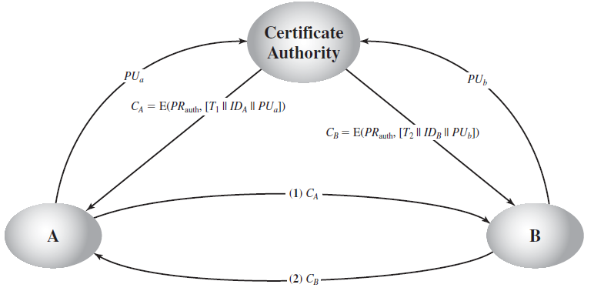
Distribution of Public Keys
4. Exchange of Public-Key Certificates

Slide 26
Distribution of Public Keys
Exchange of Public-Key Certificates
Each participant applies (in person or by some form of secure authenticated communication) to the CA, supplying a public key and requesting a certificate.
The timestamp validates the currency of the certificate. The timestamp serves as something like an expiration date.
The timestamp counters the following scenario.
A’s private key is learned by an adversary.
A generates a new private/public key pair and applies to the CA for a new certificate.
Meanwhile, the adversary replays the old certificate to B.
If B then encrypts messages using the compromised old public key, the adversary can read those messages.

Slide 27
Distribution of Public Keys
Public-Key Certificate(X.509 certificate)
X.509 certificates are used in most network security applications, including IP security, TLS, S/MIME.
Each certificate contains the public key of a user and is signed with the private key of a trusted CA.
In addition, X.509 defines alternative authentication protocols based on the use of public-key certificates.
X.509 is based on the use of public-key cryptography and digital signatures.
X.509 does not dictate the use of a specific algorithm but recommends RSA.

Slide 28
Distribution of Public Keys
Public-Key Certificate
Certificates are assumed to be created by some trusted CA and placed in the directory by the CA or by the user.
The directory server itself is not responsible for the creation of public keys or for the certification function; it merely provides an easily accessible location for users to obtain certificates.
Example of Certificate: http://www.tldp.org/HOWTO/SSL-Certificates-HOWTO/x64.html

Slide 29
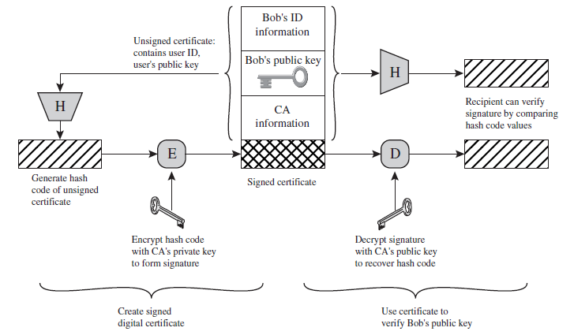
Distribution of Public Keys
Public-Key Certificate

